Slide 1
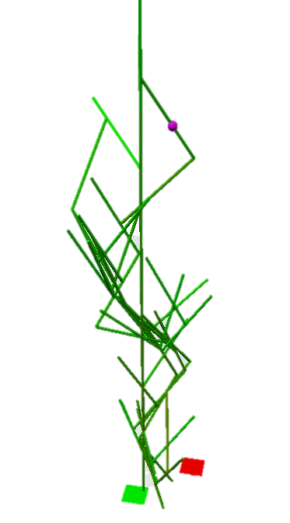
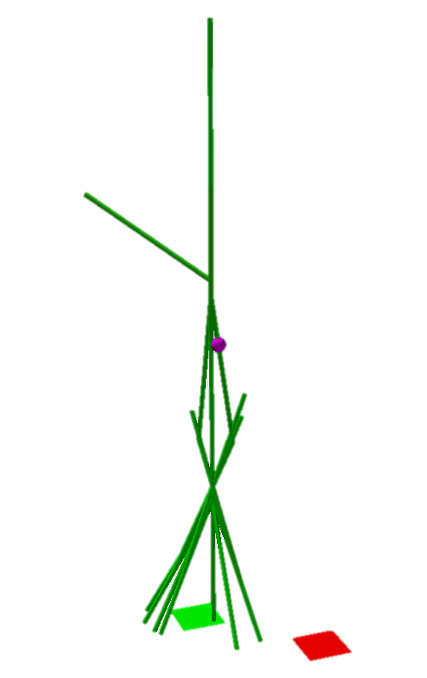
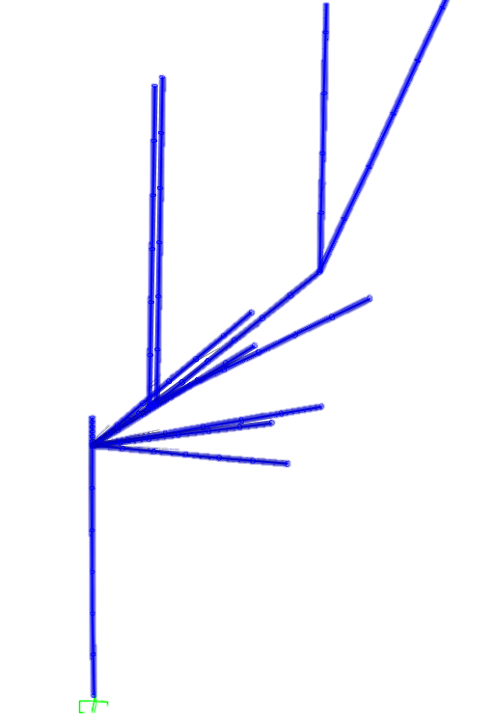
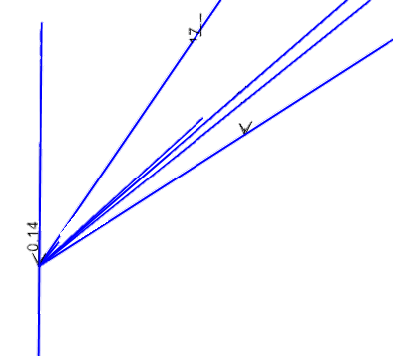
Decentralized, Collective Robotic Construction
Simulation of vertical, self-supporting structures
Notes:
Decentralized, Collective Robotic Construction
Having a Swarm of Autonomous Robots create a structure which accomplishes a general goal.
There is no need to provide the robots with a design – the structure is designed on the fly

Slide 2
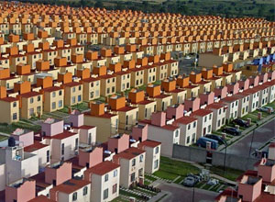
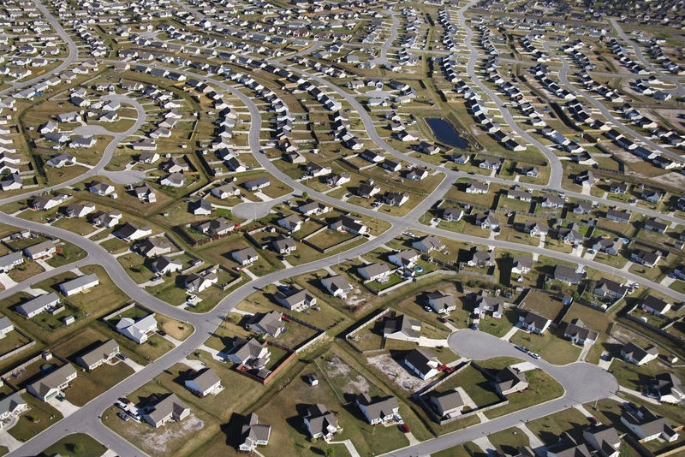
Modern construction revolution
One Design, Million Homes
Ctrl-C, Ctrl-V, -V, -V, -V
http://blog.redfin.com/local/wp-content/uploads/sites/2/2008/06/suburbs.jpg
http://www.newclearvision.com/wp-content/uploads/2011/05/suburbs.jpg
Notes:
Two main ways we currently go about construction. Both with no autonomous robotic help.
Suburban sprawl. Often times flatten entire stretches of land simply to accommodate the “one design” we have in mind.
This is done because the “one design” takes countless of hours to create.
Copy and Paste onto the planet, rarely taking into account individual geographic properties. If we do take it into account, it’s usually in a general way – the climate in this area, (Great Plains, Midwest, East Coast, etc.) tend to be this way (Cold, Warm, etc.) most of the time.

Slide 3
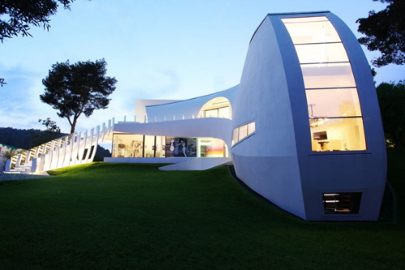

Modern construction revolution
One Design, Million Homes
One project, million dollar design
Ctrl-C, Ctrl-V, -V, -V, -V
http://blog.redfin.com/local/wp-content/uploads/sites/2/2008/06/suburbs.jpg
http://picturesplace.files.wordpress.com/2010/04/wpid-outrageous-modern-homes-casa-son-vida-1-the-luxury-spanish-villa-by-marcel-wanders-3.jpg
http://www.newclearvision.com/wp-content/uploads/2011/05/suburbs.jpg
http://blogs.voanews.com/science-world/files/2012/11/160554main_jsc2006e43519_high.jpg
Notes:
Spend countless hours making one design which takes into account how to best adapted it to the environment.
Either because we want to, as is the case with modern mansions, etc. or because it is required because the environment in which it exists is extreme – a one time deal.

Slide 4
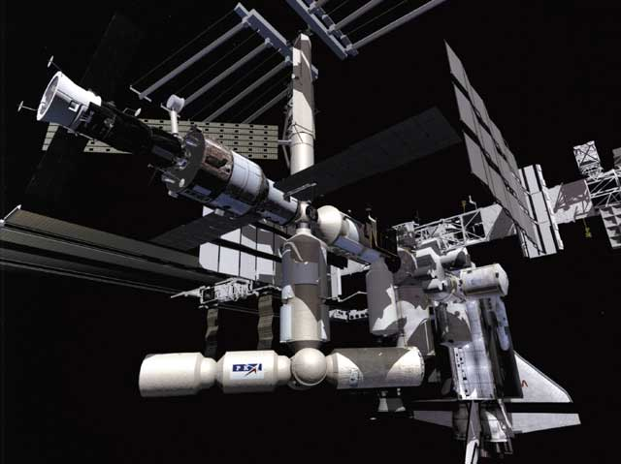
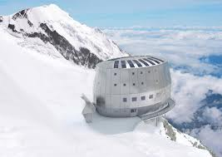
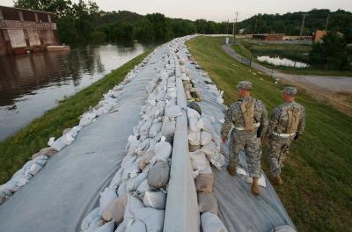
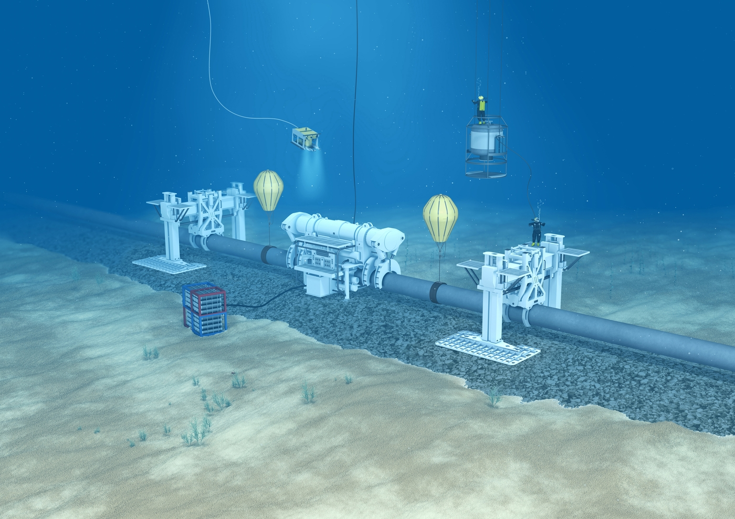
Modern construction revolution
Notes:
Extreme requires an adaptive design, but is dangerous for people, and expensive to construct.

Slide 5
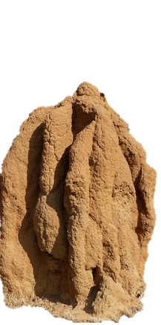
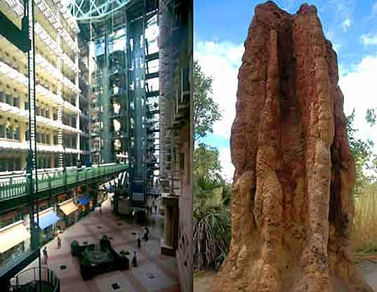
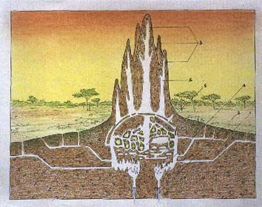
Nature-inspired Solution
Adaptive
Reactive
Little design
Set of goals
Structurally stable
http://assets.inhabitat.com/files/eastgatew_mound1.jpg
http://www.ldc.upenn.edu/myl/abm/termite1.jpg
http://people.seas.harvard.edu/~jkwerfel/
Notes:
As I’ve mentioned, we want something adaptive, which can react to environmental changes, and which requires little direct human input – little design.
We give a set of goals, the robots construct it, and the structure doesn’t fall. At no step during the construction process is the structure unstable, even with all of the robots climbing on it.

Slide 6
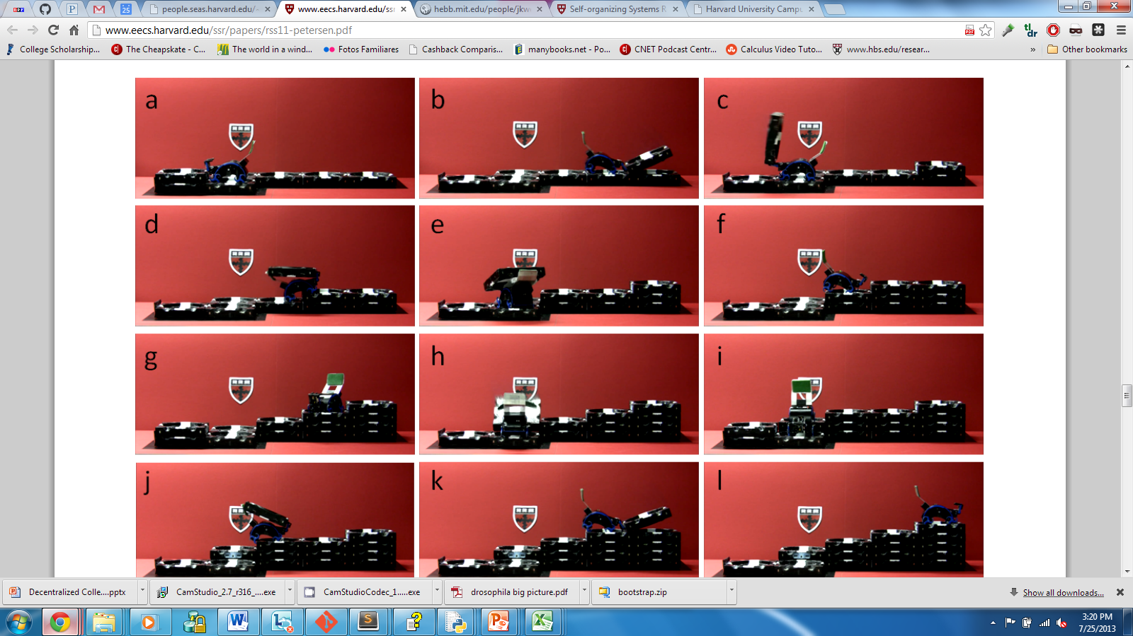
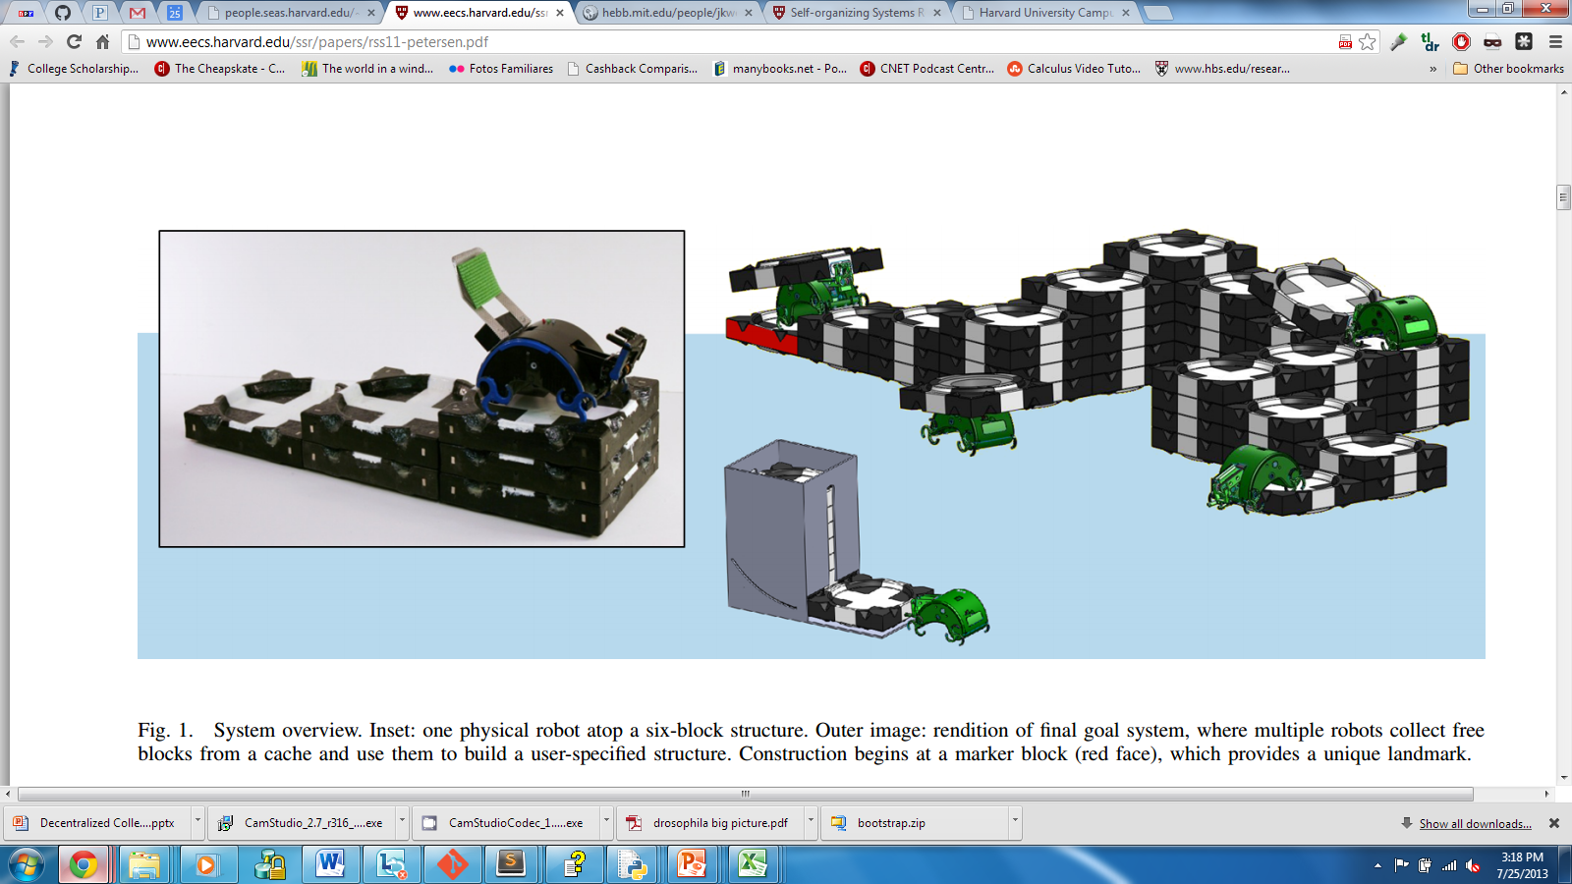
Collective Construction
TERMES Project
Physical robots
Stigmergy
Taking advantage of environment
Notes:
There’s been research into this area already.
The TERMES project is one example. Replaceable robots adaptively constructing a structure larger than themselves.
But more generally, what has been researched is the idea of stigmergy - of using the environment to store information instead
No direct communication because it is inefficient at large scales
No central blue-print – no robots dedicated to a certain area of construction
So what we need to do is take advantage of the information in the environment – even the passive information which the robots don’t themselves store

Slide 7
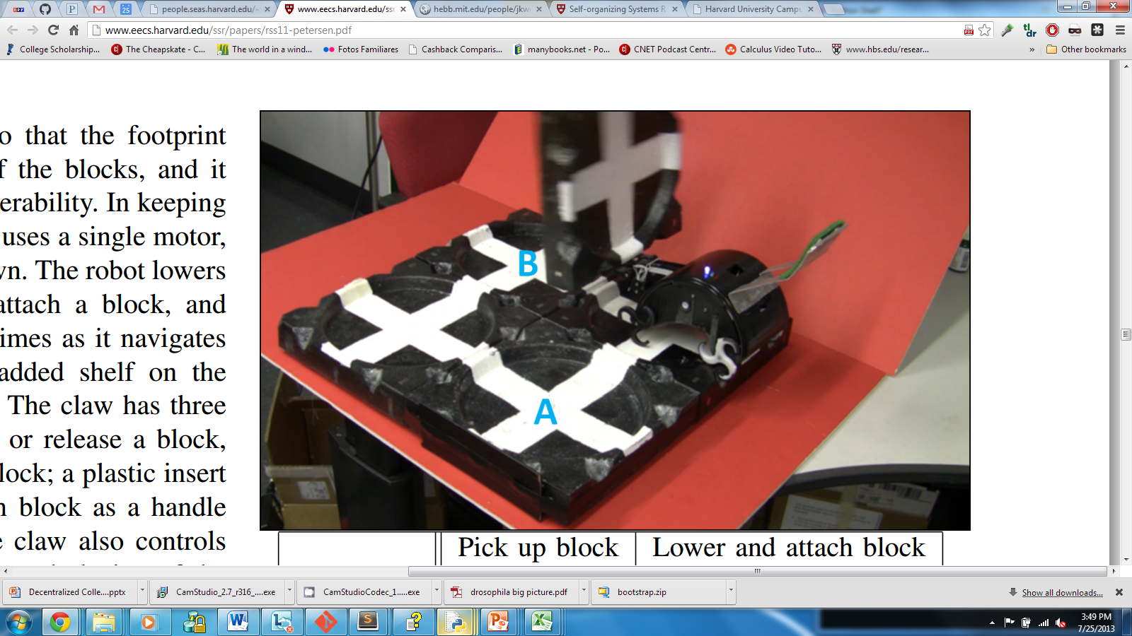
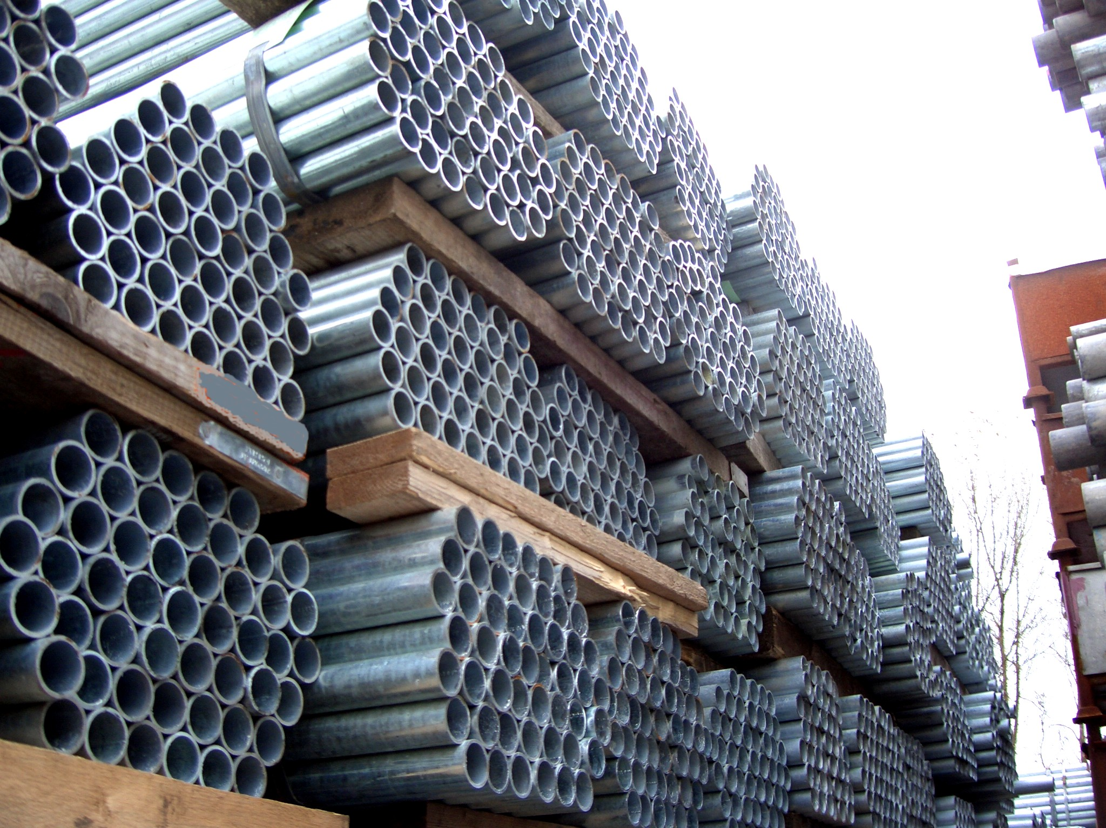
Decentralized Construction
Physically sturdy
Stable at all times
Sturdy, but unstable if built incorrectly

Slide 8
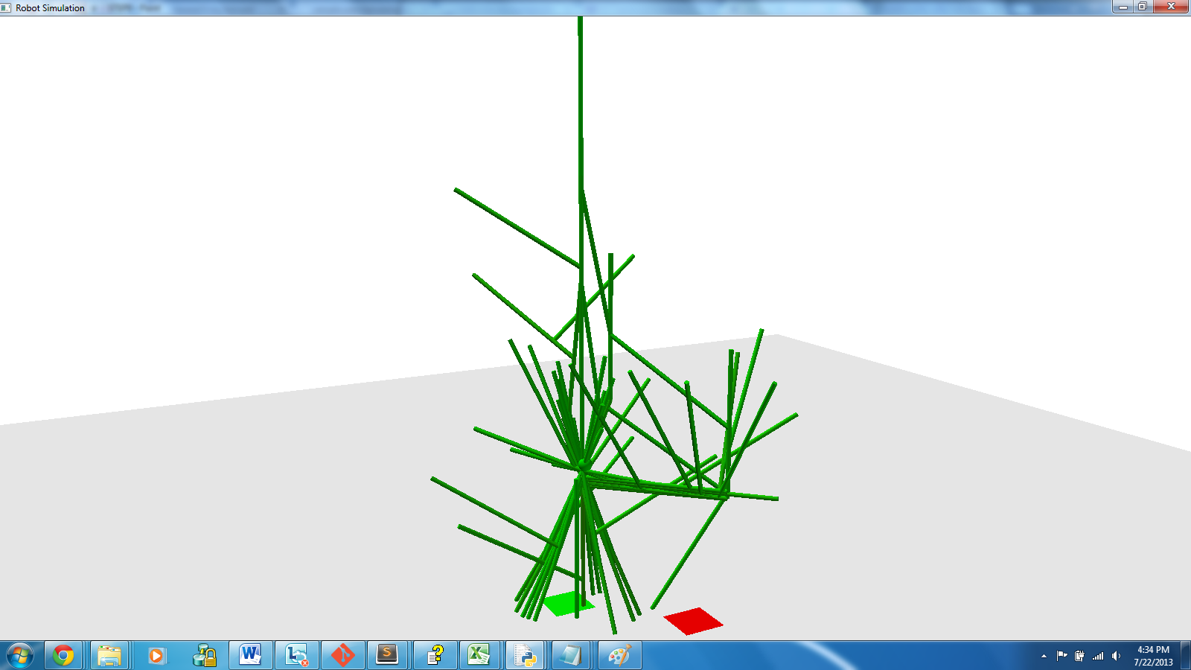
Project overview
Software suite
http://www.csiberkeley.com/files/images/SAP15_770.jpg
Notes:
Python 3.2.2
VPython 5.74 for Visualization
PyWin32 for Windows Interface
Xlsxwriter library

Slide 9

Project overview
Software suite
Materials, inputs, Physics of Simulation
http://www.csiberkeley.com/files/images/SAP15_770.jpg
Notes:
Structural Analysis Program (SAP) 2000 v15
SAP Open Application Programming Interface (OAPI)
Moment of Force

Slide 10
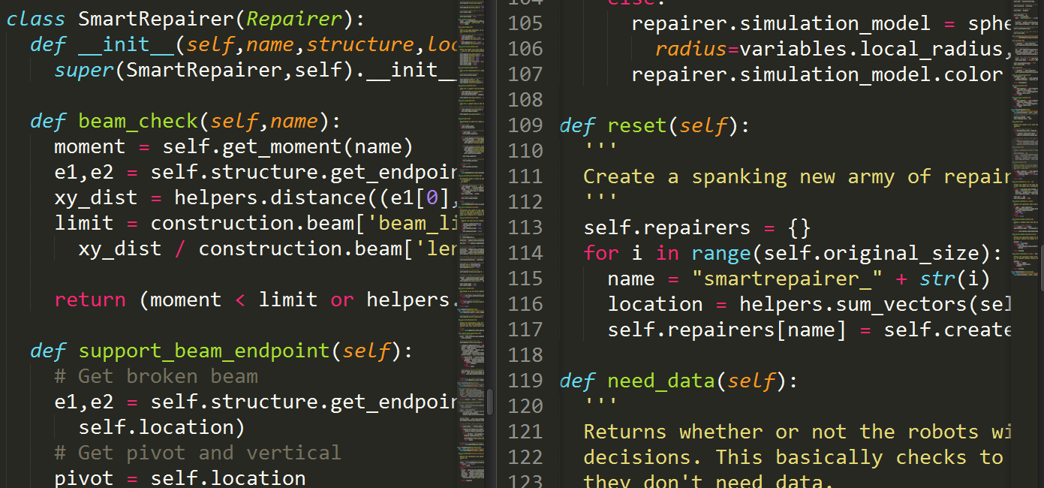
Project overview
Software suite
Materials, inputs, Physics of Simulation
Swarm’s algorithm
http://www.csiberkeley.com/files/images/SAP15_770.jpg
Notes:
Runtime Execution (per timestep)
Decision Step
Action Step
Construct mode, support mode, repair mode, ground mode

Slide 11
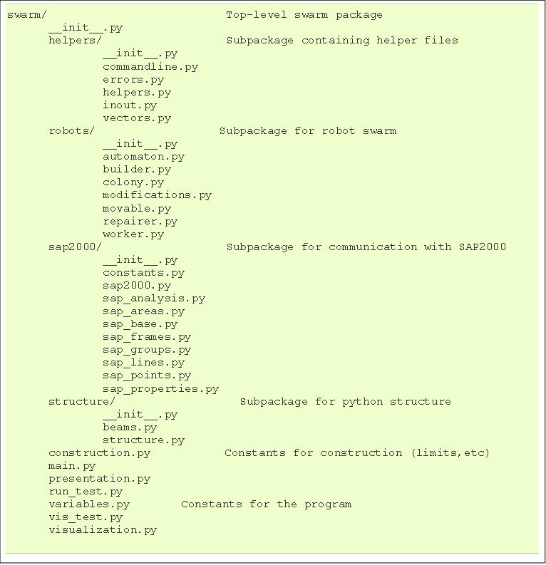
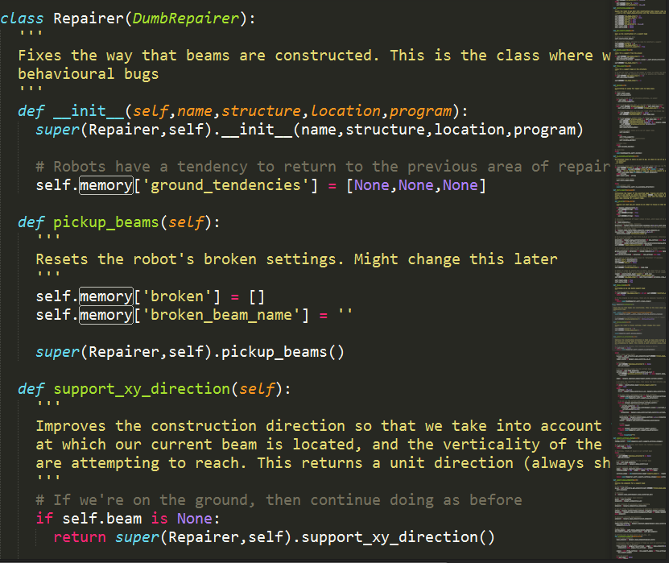
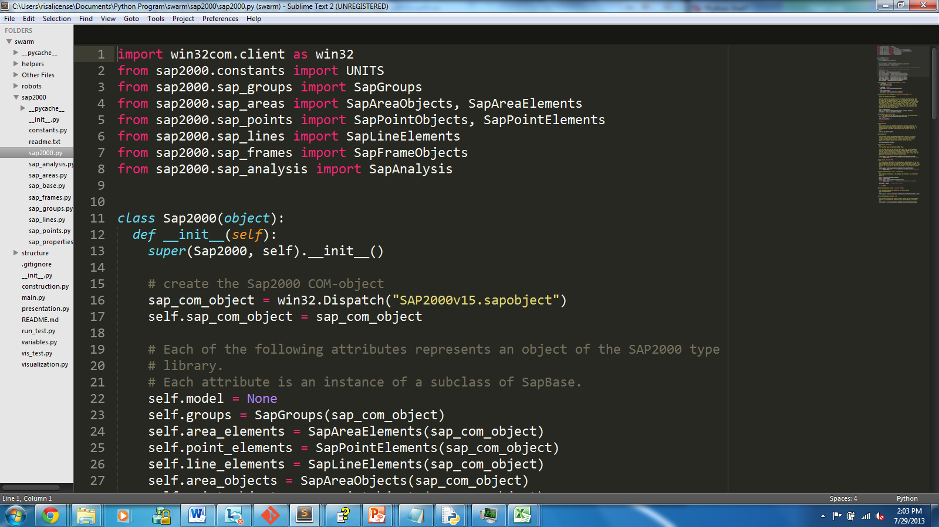
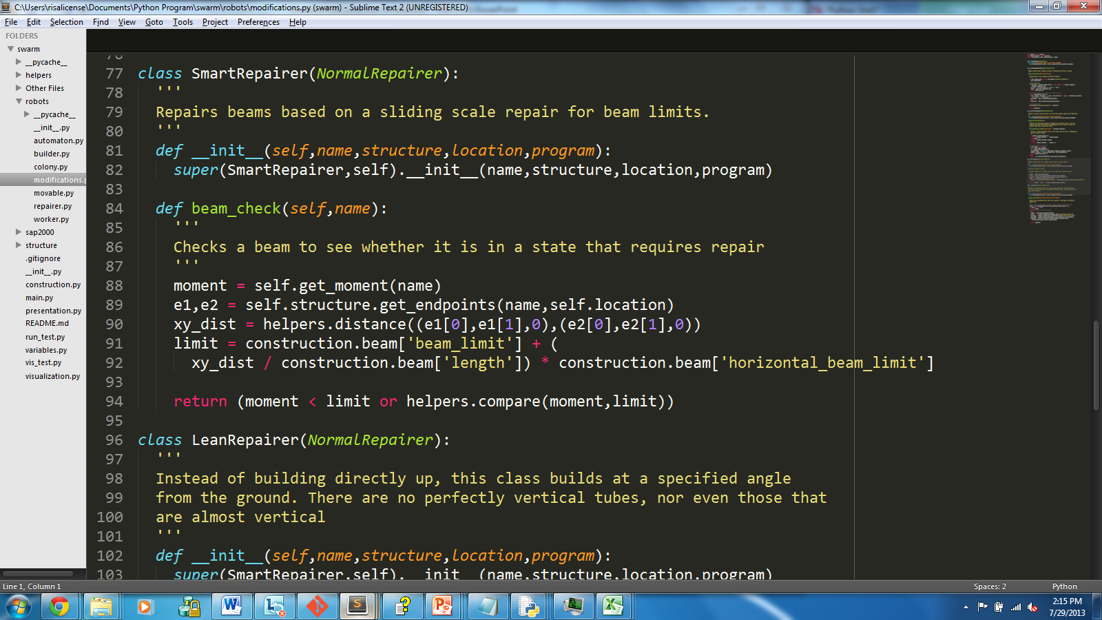
Python Package - Swarm
Python Specific OAPI
Sap2000 package
Swarm Logic
Repairer.py
Base class
Modifications.py
Python-ic Structure Storage
Main code
Execution, visualization, constants, presentation

Slide 12
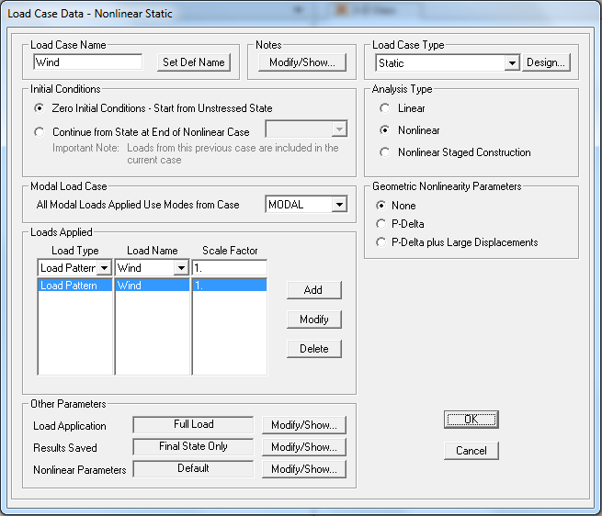
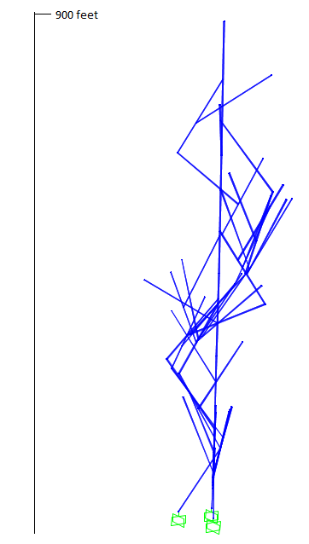
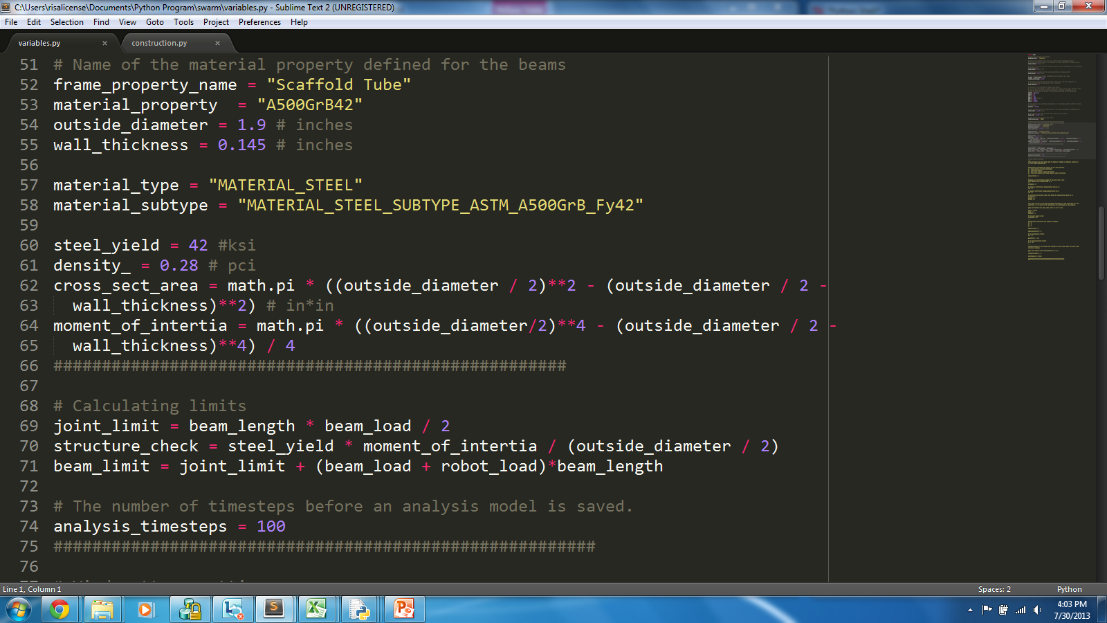
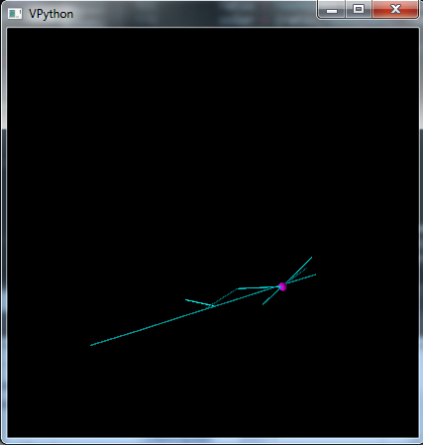
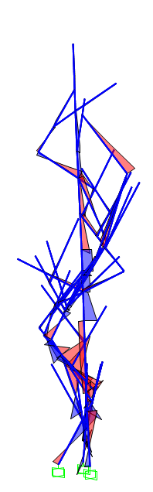
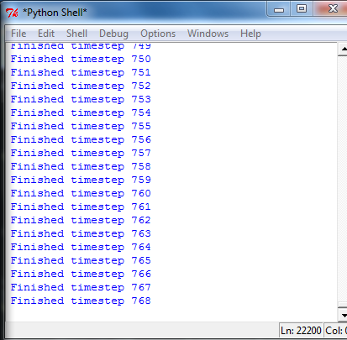
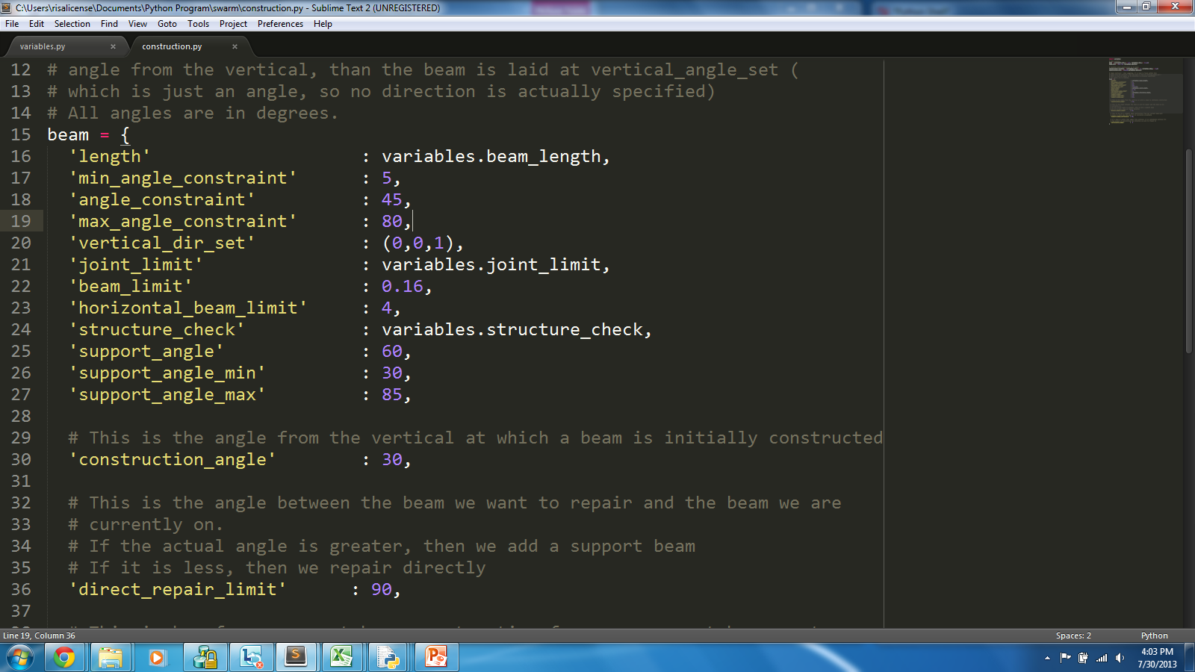
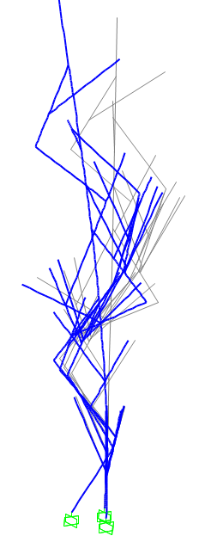
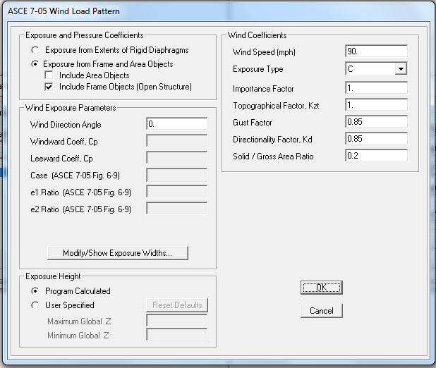
Methods: Virtual Tower Construction Simulation
Explore
Set Rules – repairer.py
Execute simulation
Analyze
Failed Model Analysis
Modify
How, why?
Previous Model Results
modifications.py – new rules, logic changes
Model template file
Visualization
Structure Analysis
variables.py, construction.py – constant changes
Set wind
height
moments
deflection

Slide 13
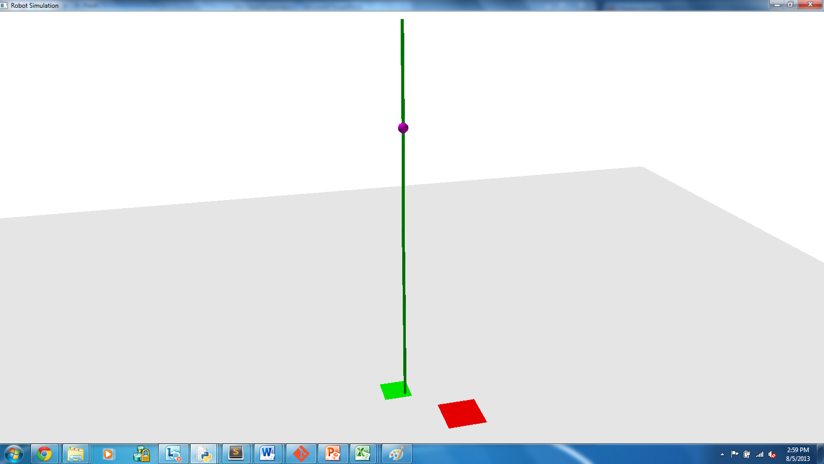
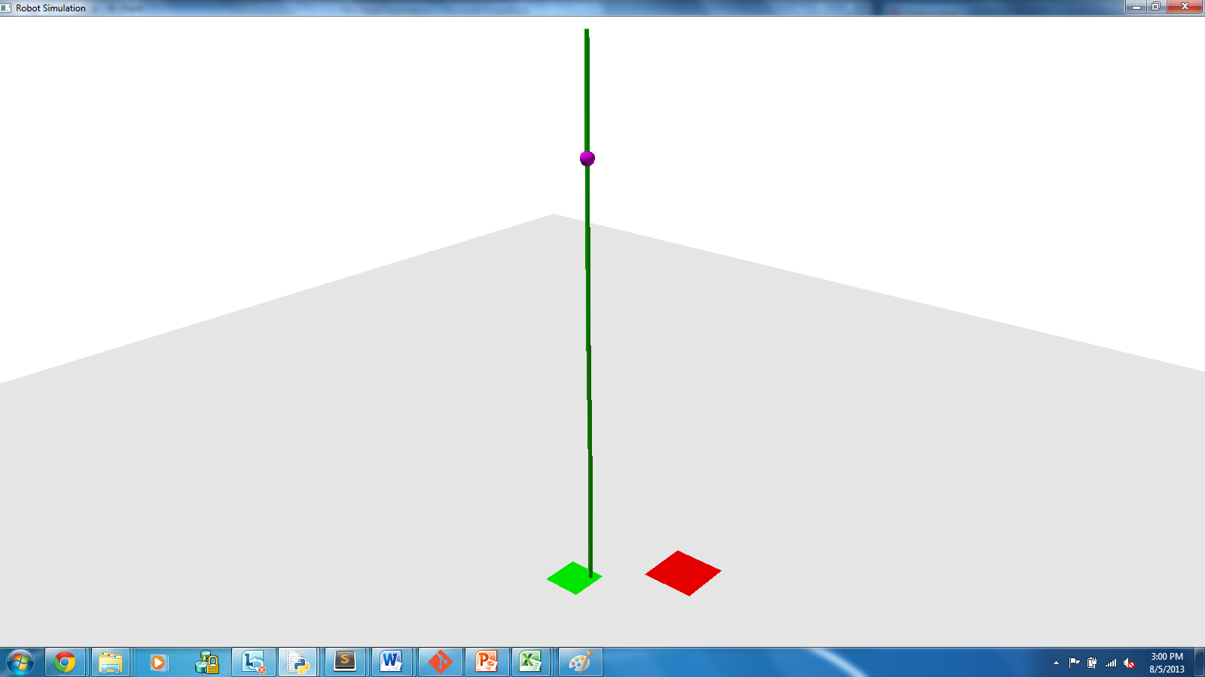
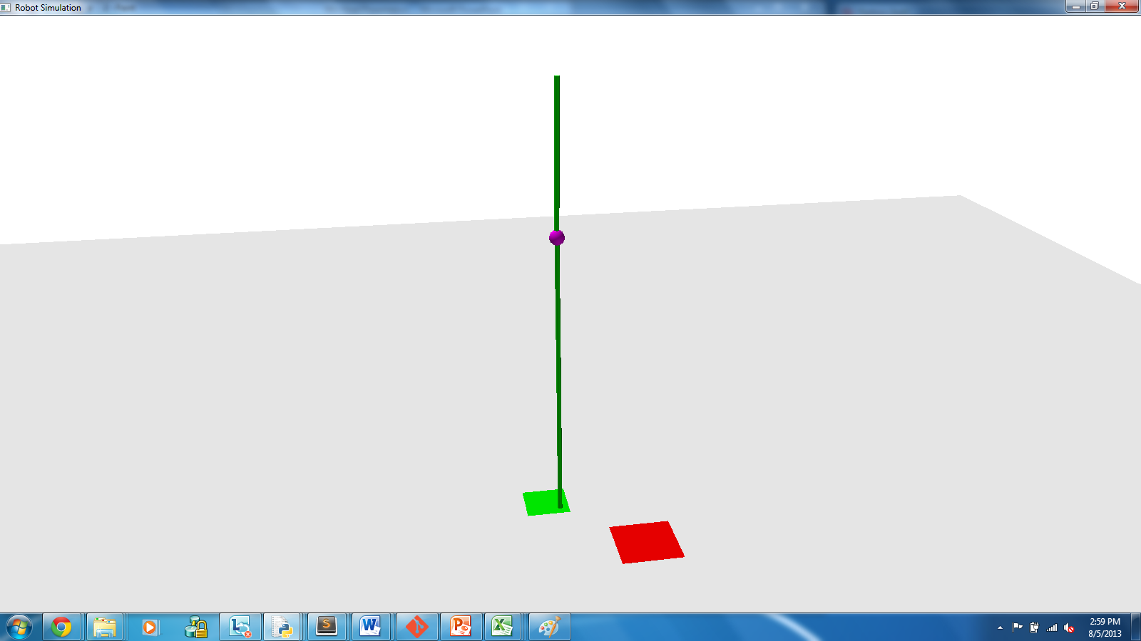
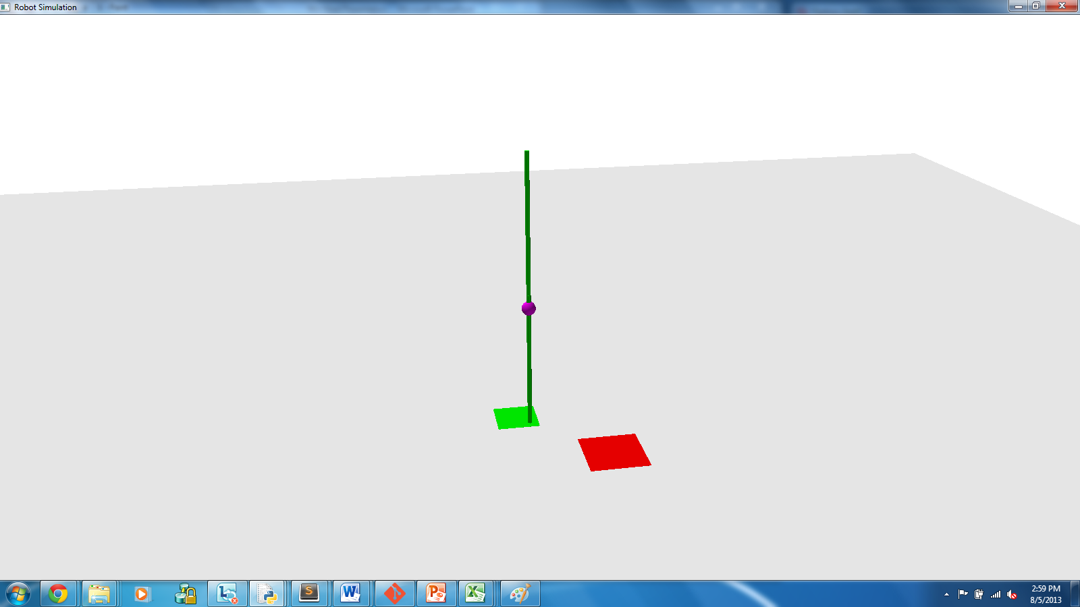
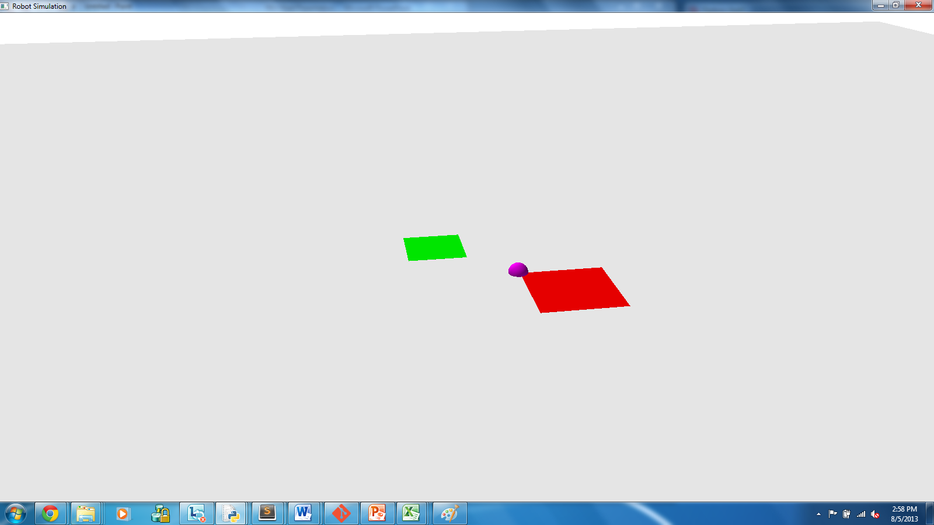
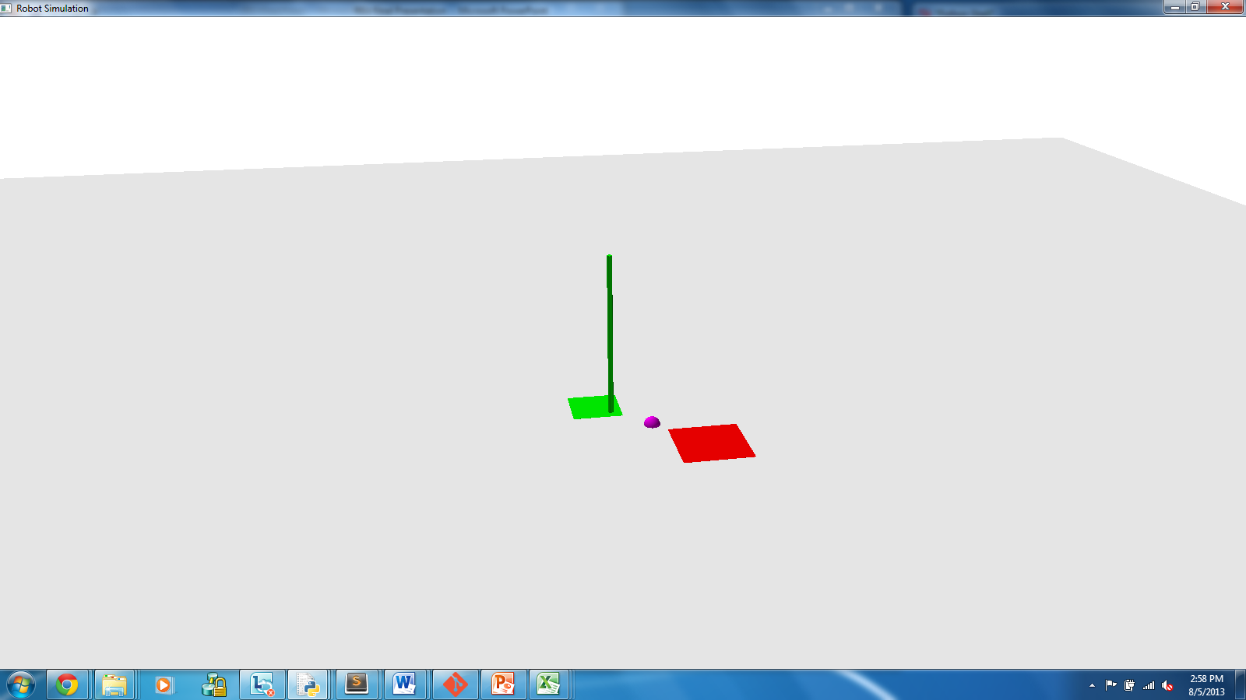
Construction – Simple Limit
Notes:
Using a simple limit of 1.0 kip-inches to determine moment when “repair” should be activated.
10 ft Scaffold tube with
outside_diameter = 1.9 inches
wall_thickness = 0.145 inches
== Structural limit of 13.7 kip-in

Slide 14
Simple Limit – In Depth
Notes:
Normal Repairer:
Moment of beam agent is on at agent location – maximum of a surrounding area

Slide 15
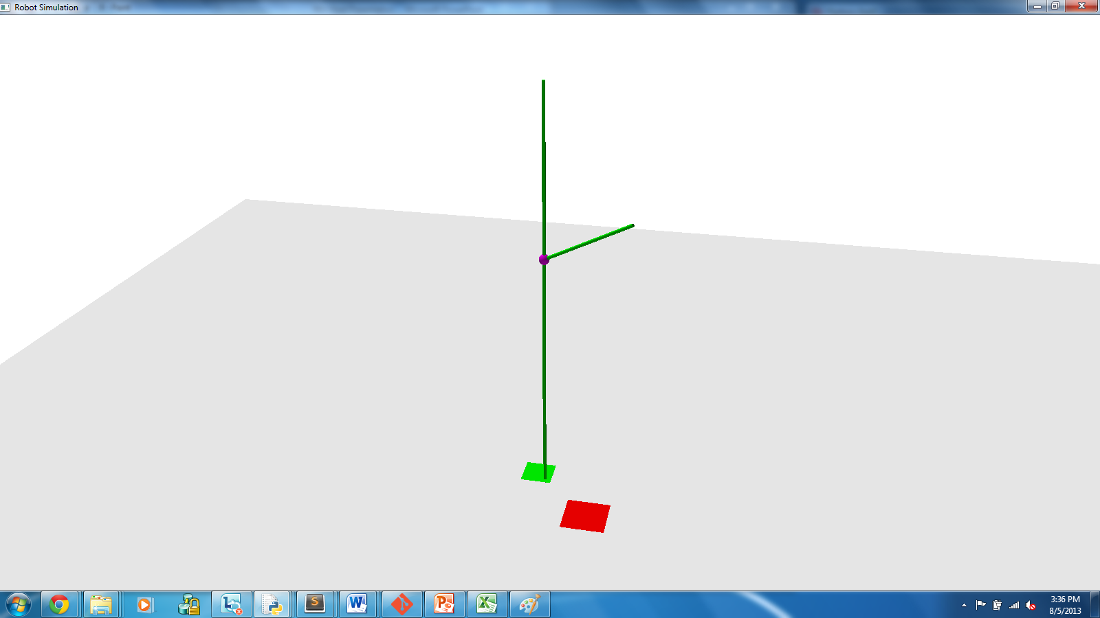
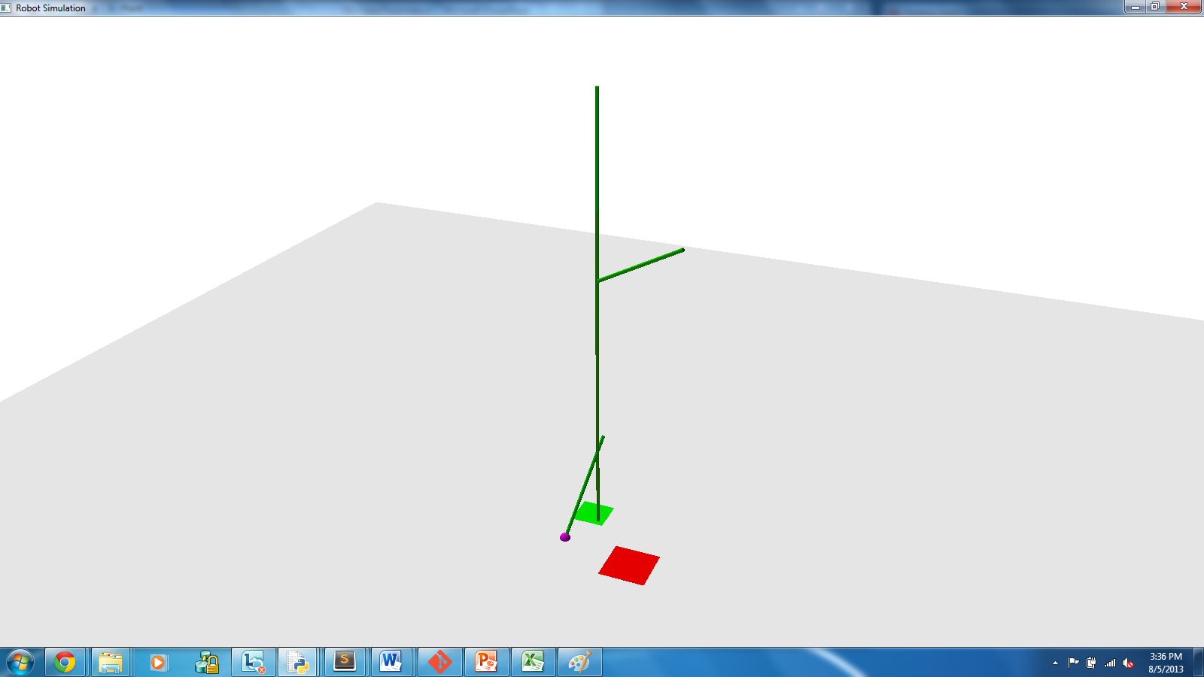
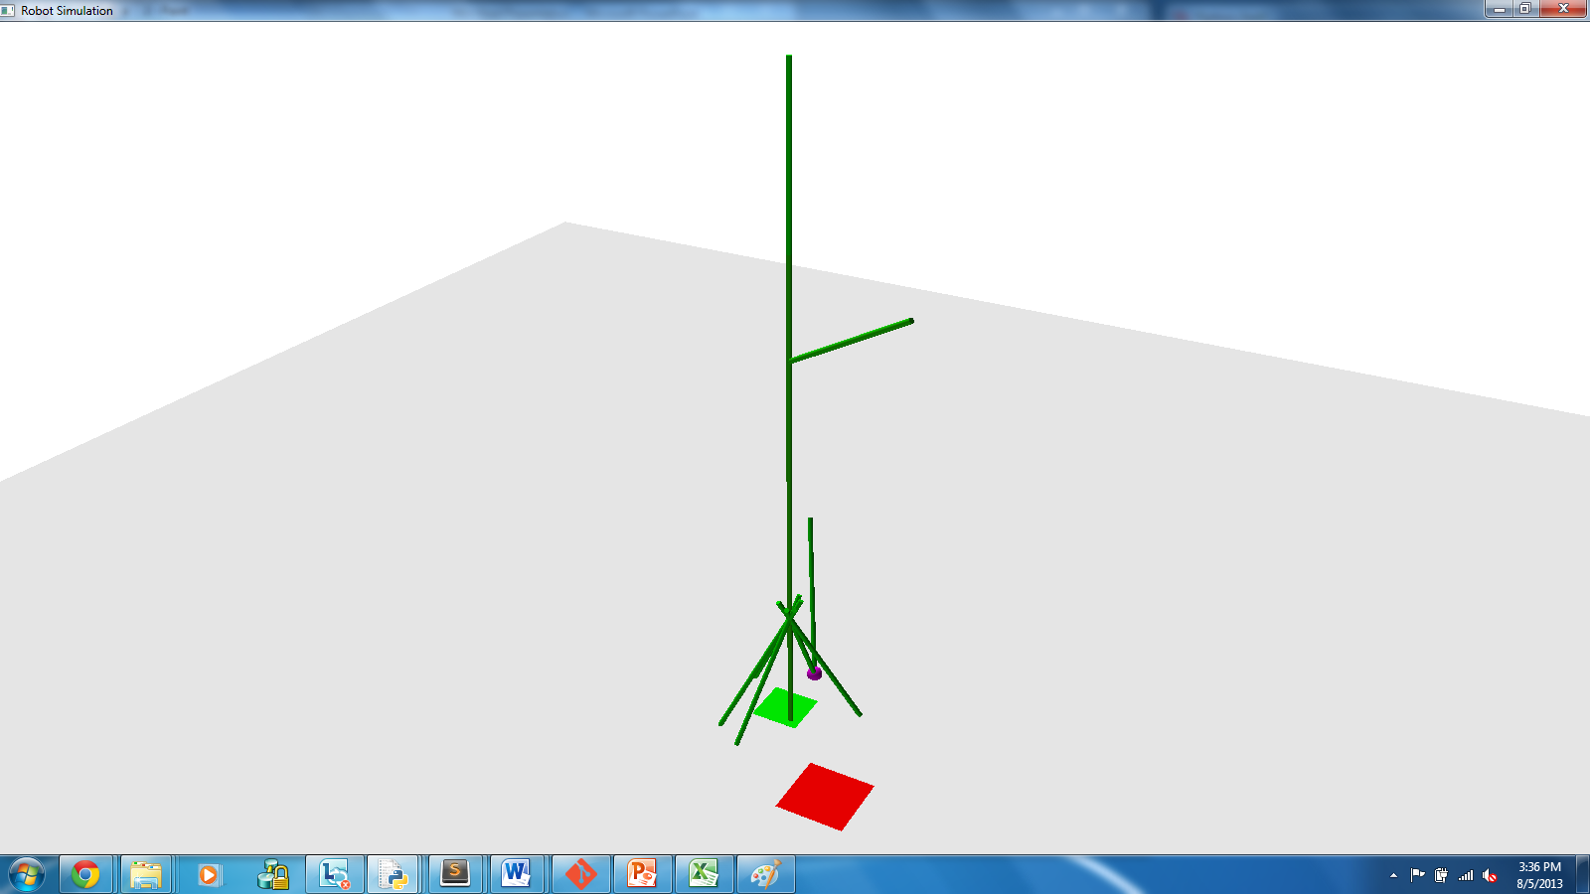
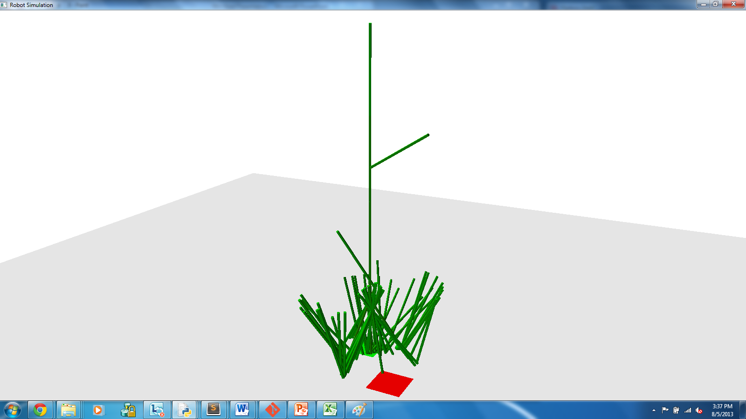
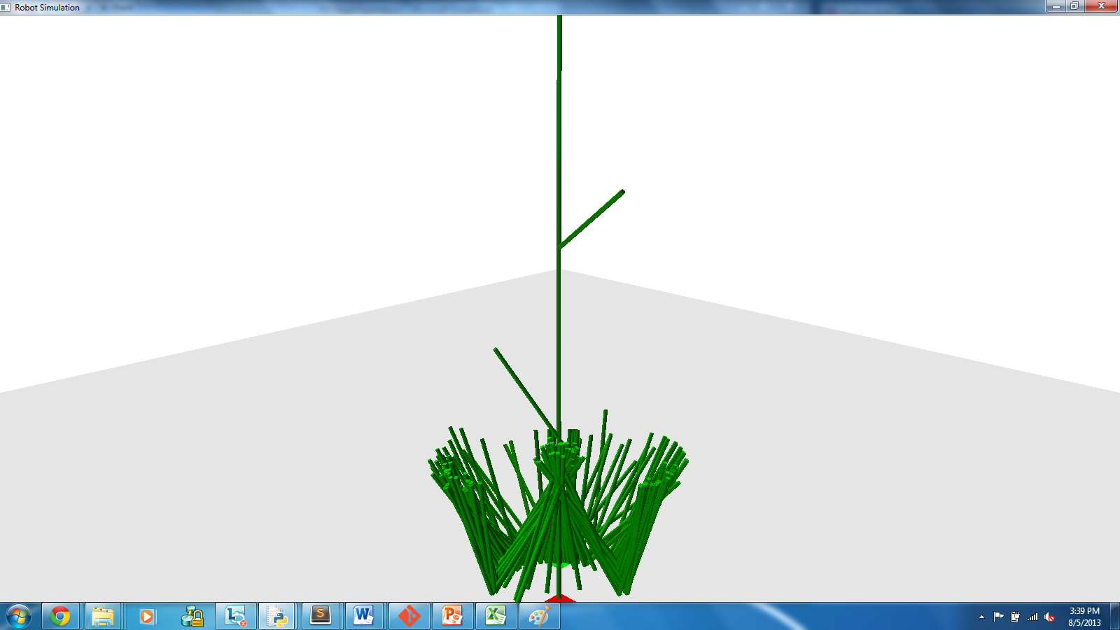
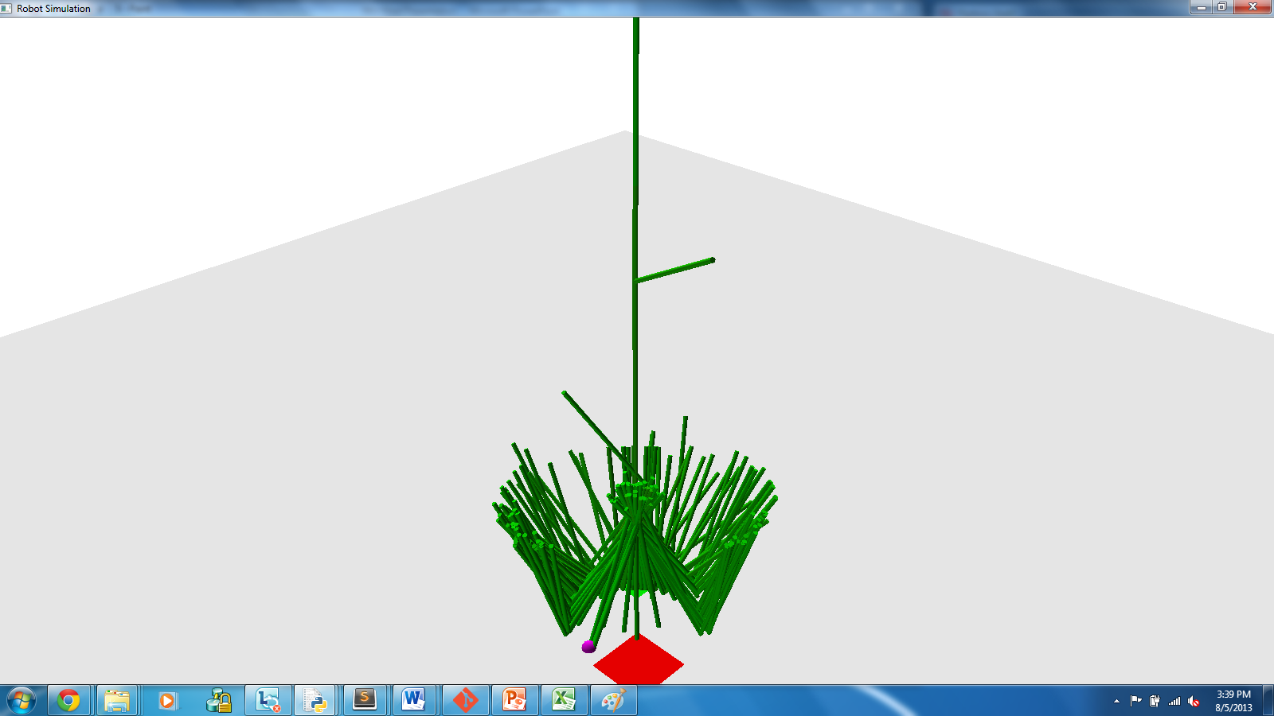
Construction – Simple Limit Lowered
Notes:
Simple solution would be to lower the limit.
Have the robots “over-reinforce” each beam
Would theoretically just take longer than optimal, plus serve as test for simulation
Ended with flower like base
There exists a limit below which leaning beams will not drop
Over-repairing = never moving up
Additionally, probably pushed the problem further out but did not fix

Slide 17
Importance Scale
Notes:
Our way of building leads to:
Tendency to place beams vertically unless supporting something else
Unsupported beams tend to be in vertical position
Tendency to climb upwards
Leads to vertical beams “chaining” into one beam
Chained beam increases sensitivity of entire structure
Lowering limit only pushes the problem further down
Increases repair
Importance Scale
The verticality of a beam determines how important it is that we repair it
Vertical beams have lower “triggers”
Horizontal beams have highest “triggers”

Slide 18
Conclusions

Slide 19
Acknowledgements

